Slide 1

Backpropagation learning by Cross Entropy Loss Function
We have discussed about Backpropagation learning in Multi Layer Feed Forward Neural Network.
The cost or error function to be minimized was sum of square error or quadratic error.
The weight updation rule that we have derived was based on the sigmoid activation function, which is
, where
For small or large values of sigmoid activation function,
, which gives very small gradient. Which means either the learning process is very slow or it stops when gradient vanishes.
This is one of the major problem of using sum of square error or quadratic error function.

Slide 2
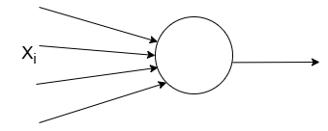
Cross Entropy Loss Function for binary class problem
Let us consider Cross Entropy Loss for 2 class problem, i.e., y =1 and y=0.
Let, for a training sample
X_{i}, actual class is y=1
and the predicted value
is , so is the likelihood
that the actual class of X_{i} is y=1.
So 1- is the likelihood that the actual class of X_{i} is y=0.
W

Slide 3

Cross Entropy Loss Function for binary class problem
Combining these two, we get likelihood to be maximized is equal to
Loglikelihood to be maximized to train the network is:
If X_{i} is in class y=1, we have to maximize and if X is in class y=0, we have to maximize
From the likelihood we can define the cross entropy loss function to be minimized, as follows:
So we have taken the summation over all N training samples and take the average, which gives us the cross entropy loss function C which is to be minimized as we consider negative sign.
This is called binary cross entropy as there are two classes.

Slide 4






Backpropagation Learning using Cross Entropy Loss Function for binary class problem
We will minimize using gradient descent approach, where,
The gradient is:
and

Slide 5

Backpropagation Learning using Cross Entropy Loss Function for binary class problem
Let us consider, stochastic gradient descend approach, then
If X_{i} is of class y=1, and misclassified as ŷ = 0, then weight increases, and
If X_{i} is of class y=0, and misclassified as ŷ = 1, then weight decreases.
But in case of sum of square or quadratic error function, the
weight updation rule is:
Here, if activation function value, i.e., ŷ_{i} is very small or very large, then the gradient almost vanishes, which provides slow learning to the network.

Slide 6
Backpropagation Learning using Cross Entropy Loss Function for binary class problem
The cross entropy loss function is :
If activation function value, i.e., the predicted value ŷ_{i} is very large when y=0 then the difference (ŷ - y) is very large, and when ŷ is very small for y=1 then the absolute difference (ŷ - y) is also very large.
Therefore, the learning rate is proportional to the absolute value of the difference of actual and predicted value.
So, if the error is more then the rate of learning is more.
But in sum of square error, if error is more, i.e., ŷ =0 for y=1; or ŷ=1 for y=0, then updation portion or step size of updation (contains ŷ (1- ŷ)) is very less (since, ŷ is the sigmoid function value). So the learning rate is very slow, even may be stopped when gradient vanishes.
Thus the cross entropy loss is advantegious over quadratic error.

Slide 7
Backpropagation Learning using Cross Entropy Loss Function for Multiclass problem

Slide 8
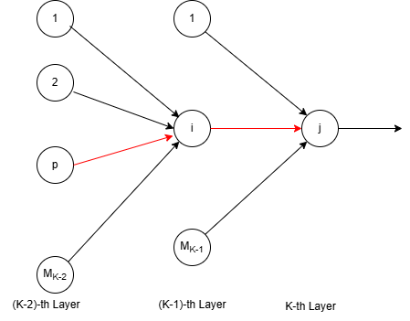
Cross Entropy Loss Function for Multiclass problem
In multiclass problem where we are using cross entropy, we assume that the outputs of the output layer neurons are obtained in a probabilistic manner.
That is the outputs are softmax output, which we can obtain by using the softmax classifier at the output layer.
It gives the normalized probability that input vector X belongs to class t_{j}.

Slide 9



Cross Entropy Loss Function for Multiclass problem
Let, be the likelihood that the sample X belongs to class t_{j}
(1- ) is the likelihood that X is in class (1 – t_{j})
So, for j-th output node, the cross entropy loss is:
Considering all the output nodes, we get the overall cross entropy loss:
So, considering all the feature vectors, we get the final cross entropy loss function as:

Slide 10









Backpropagation Learning using Cross Entropy Loss Function for Multiclass problem
We have to minimize
where, and
So, the weight updation rule is:

Slide 11

Backpropagation Learning using Cross Entropy Loss Function for Multiclass problem
Here, the weight updation rule is:
If is more, i.e., if error is more then the updation part or step size of updation is more.
So, the learning rate is proportional to the error.
This is the advantage of cross entropy over quadratic error.
But it should be remember that to use the cross entropy loss, the output of the neural network must be a softmax output, because it has to be a probabilistic measure.

Slide 12
THANK YOU

